Slide 1
CLASSROOM RULES
1.Be on time
2.Be interactive
3.100% or Nothing
4.Do all Daily Challenges

Slide 2
LESSON 10
DETERMINERS
Brought to you by LangGo

Slide 3
REVIEW: DAILY CHALLENGE
GRAMMAR + VOCABULARY

Slide 4
REVIEW: LISTENING
What’s your brother’s wife like?
How do you like the new teachers?
She’s great to be with because she makes me laugh all the time.
He’s really friendly and easy to talk to.
He loves going out and meeting people. We go to parties all the time.
She loves giving things to people. And she doesn’t expect anything in return.
She never seems to smile. I wonder why she’s so serious all the time.
All they like to do is sit at home and play computer games.
He’s kind of shy and not very talkative.
She always looks like she’s in a bad mood.
When someone tells a really funny joke, we all laugh, but she doesn’t seem to think it’s funny.
He never talks to anyone. He just sits there and talks to himself.
It’s difficult to get him to laugh. I guess he’s pretty serious.
He always asks a new girl out on a date every weekend. I don’t like guys like that.

Slide 5
REVIEW: SPEAKING
Talk about the personality of all members in your family.

Slide 6
TYPES OF DETERMINERS
01
02
03
04
05
06
Article
Possessive
Demonstrative
A, an, the
My, your, our, her, his, its, their
This, that, these, those
Numerals
Ordinals
Quantifiers
One, two, three
First, second, third
Some, many, any

Slide 7
OBJECTIVES
Articles: A, An, The
Possessive determiners
Demonstrative determiners

Slide 8
01
Articles

Slide 9
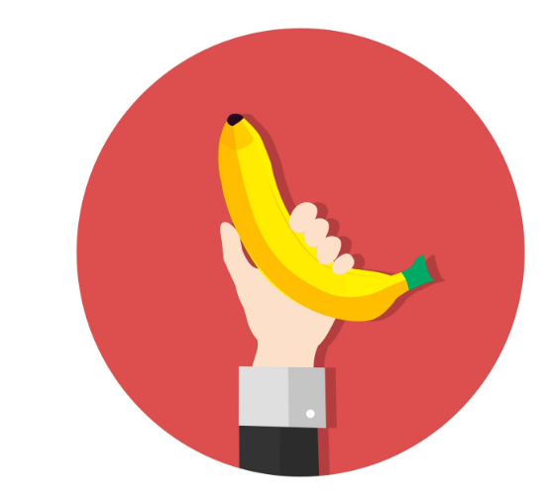
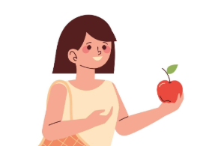
A/An: Mạo từ không xác định
I have an apple.
I have a banana.
an đứng trước nguyên âm
a đứng trước phụ âm
Dùng để nói về 1 cái gì đó không cụ thể, chưa xác định
Notes:
The words a and an are called indefinite articles. You can use them with singular nouns to talk about any single person or thing.
The article an is usually used before words
beginning with vowels. The article a is used
before words beginning with consonants.

Slide 10
THE: Mạo từ xác định
1. Antarctica is the coldest place in the world.
2. I want to visit the USA.
3. She lives in a big house. The house has a garden.
4. The girl whom I met yesterday is my new friend.
5. The old need our help.
Why do we use ‘The’ in these sentences?
Dùng khi nói về cái gì đó đã xác định, người nói/ người nghe đã biết

Slide 11
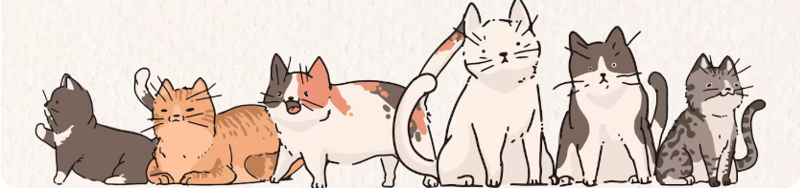
Lưu ý:
Không dùng mạo từ khi:
Đứng trước các danh từ không đếm được/ đếm được ở dạng số nhiều, mang nghĩa chung chung, không cụ thể
I love cats.
Doctors have to study for a long time.
Water is essential for life.
Đứng trước các danh từ trừu tượng
Love is more important than money.
Đứng trước meals, languages, sports, và các cụm về place and time
I never drink before breakfast.
I'll see you next week.
He stayed at home because he was ill.
Do you play tennis?

Slide 12
Fill in the blanks with a/an/the:
I live in ___ small house. There are 5 rooms in my house: a living room, 2 bedrooms, a bathroom and a kitchen. My favorite room is the living room. There is ___ old sofa in _____living room, and there is ___ armchair next to the window. In the middle of _____ room, there is__ new rug. It’s very cozy. Then, there’s my bedroom. It has ___ orange curtain. On the right side of ____ room, there is___ bed, and _____ table is next to _____ bed. _____ book is placed on _____ table. We also have ___ big kitchen with ___ oven. My family always eat dinner here together. I love my house.

Slide 13
Key:
I live in a small house. There are 5 rooms in my house: a living room, 2 bedrooms, a bathroom and a kitchen. My favorite room is the living room. There is an old sofa in the living room, and there is an armchair next to the window. In the middle of the room, there is a new rug. It’s very cozy. Then, there’s my bedroom. It has an orange curtain. On the right side of the room, there is a bed, and a table is next to the bed. A book is placed on the table. We also have a big kitchen with an oven. My family always eat dinner here together. I love my house.

Slide 14
02
Possessive determiners

Slide 15
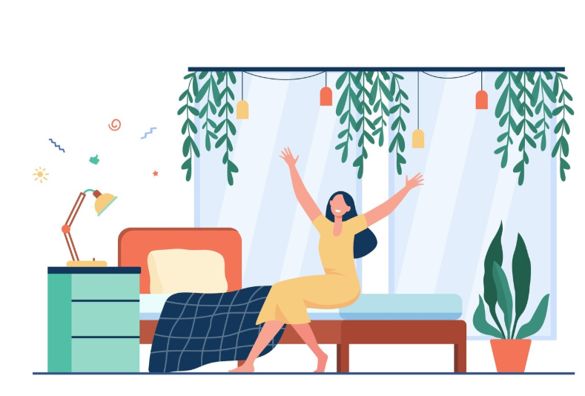
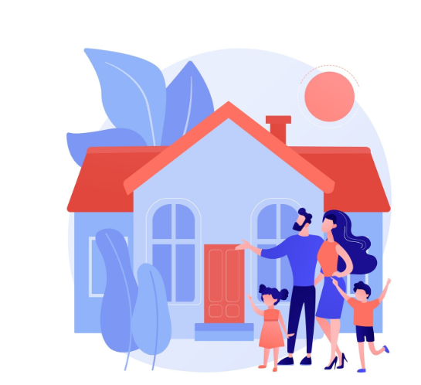
Possessive determiners
My bedroom is painted white.
Their new house has 5 rooms.
Possessive determiners: my, your, his, her, its, our, their - đứng trước danh từ để chỉ vật đó thuộc về ai

Slide 16
Fill in the blanks with the correct possessive determiners:
my
I have a bedroom right on the first floor of the house. I think ____ bedroom is lovely, because I decorated it myself. My sister’s room is next to mine. ____ room is smaller, but it’s painted white and blue. My parents have _____ own bedroom, and it is on the second floor. My dad also has his own home office - he stores all of _____ books in that room. We all like spending time at home because our home is beautiful.
Her
their
his

Slide 17
03
Demonstrative determiners

Slide 18
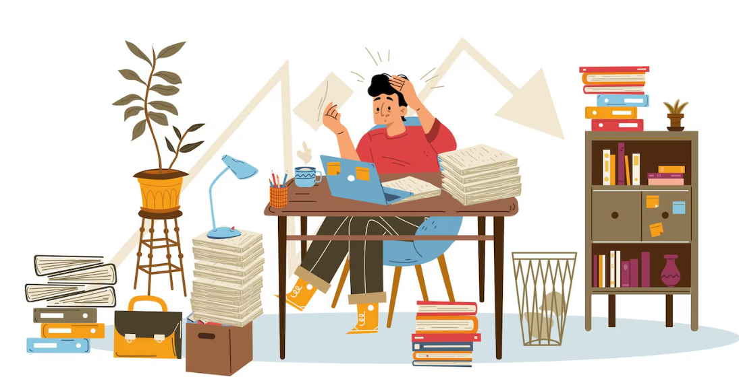
This letter is hard to understand.
Those books are on a bookshelf.
That lamp is in front of a plant.
These books are next to my laptop.

Slide 19
Fill in the blanks with the correct determiner, if the blank doesn’t need one, write NONE:
My bedroom is small, but it is very nice. When you open the door, you see ______big bed with a few pillows and ______red blanket. Next to _____bed, there is _____ small table. I keep ____ books and ____ phone on _____ table. Sometimes, my sister also leaves ___ bag there. There’s a picture on the far wall of the room, and my mom drew ______ painting. All ______walls are white, and there are some posters on the wall. On the left side of my room is my study desk - I don’t put any books there, but there’s ____ laptop on _____ desk. I also have a wardrobe full of _____clothes - but sometimes, I feel like I don’t have anything to wear!

Slide 20
ANSWER:
My bedroom is small, but it is very nice. When you open the door, you see a big bed with a few pillows and a red blanket. Next to the bed, there is a small table. I keep my books and my phone on that/the table. Sometimes, my sister also leaves her bag there. There’s a picture on the far wall of the room, and my mom drew that/the painting. All the walls are white, and there are some posters on the wall. On the left side of my room is my study desk - I don’t put any books there, but there’s a laptop on the desk. I also have a wardrobe full of none clothes - but sometimes, I feel like I don’t have anything to wear!

Slide 21
Thanks!
Do you have any questions?

